Slide 1
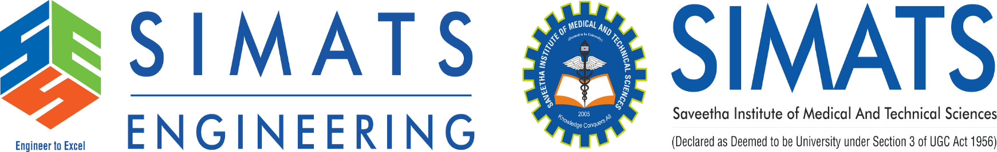
Notes:
1
1

Slide 2
Introduction
AI and Machine Learning – Automates test generation, detects defects faster, and improves test efficiency.
Shift-Left and Shift-Right Testing – Early defect detection and real-time monitoring for better software quality.
Security and Performance Testing – Identifies vulnerabilities and ensures software runs smoothly under various conditions
Continuous Testing in DevOps – Ensures rapid, automated testing throughout the development lifecycle.
Ensures software runs smoothly under various. conditions

Slide 3
Applications
AI and Machine Learning in Testing:
Automated test case generation, self-healing test scripts, and predictive
analytics for bug detection.
2. Shift-Left and Shift-Right Testing:
Early-stage testing (shift-left) to detect issues sooner, and post-
production monitoring (shift-right) for real-time error detection.
3. Performance and Security Testing
Validating model robustness, fairness, and performance by
applying mutations to models and training data.

Slide 4
Problem Statement
Modern applications involve microservices, cloud computing, and AI-driven components, making testing more intricate.
Agile and DevOps practices demand continuous testing, but traditional testing approaches often slow down development.
Many organizations struggle with unstable test scripts, maintenance issues, and limited automation coverage..
Increasing cybersecurity threats and performance bottlenecks require proactive testing strategies.

Slide 5
Objectives
Implement proactive security and performance testing strategies to prevent vulnerabilities and bottlenecks.
Improve the stability and reliability of automated tests using AI and ML-based tools.
Integrate continuous testing within CI/CD pipelines for faster software releases.
Leverage AI-driven test generation and self-healing scripts to detect more defects.
Compute the mutation score as the percentage of mutants killed.
Ensure scalable and cost-effective testing solutions for cloud-native applications.

Slide 6
Literature Review
Reference | Year | Key Contributions | Findings
Garousi, V., Felderer, M., & Mäntylä, M. V. | 2019 | Conducted a systematic mapping study on software testing practices in industry. | Found that test automation, shift-left testing, and AI-driven testing are among the most adopted trends, improving efficiency and defect detection rates.
Ahmed, M., & Capretz, L. F. | 2020 | Explored the impact of AI and machine learning on software testing processes. | Demonstrated that AI-based testing significantly reduces testing time and increases defect prediction accuracy.
Ardito, L., et al. . | 2021 | Investigated the role of DevOps and continuous testing in modern software development. | Concluded that continuous testing in CI/CD pipelines enhances software reliability and accelerates deployment cycles. .
6

Slide 7
Literature Review
Reference | Year | Key Contributions | Findings
Myers et al., The Art of Software Testing. | 2011 | Provided a foundational approach to software testing methodologies. | Highlighted the importance of rigorous test design and evolving test strategies in modern software development.
OWASP, Security Testing Guidelines | 2023 | Provided best practices for security testing. | Stressed the need for integrated security testing throughout the SDLC.
5/13/2025
7
7

Slide 8
.
Existing System
Many organizations still rely on manual testing for UI, functional, and exploratory testing.
This approach is time-consuming, error-prone, and not scalable for complex applications.
Selenium, Appium, and JUnit are widely used for automation but require constant maintenance.
Test scripts often break due to frequent UI and functionality changes, leading to high maintenance costs.
The current landscape of software testing is primarily driven by manual testing, automated testing, and DevOps-integrated continuous testing.
8

Slide 9
Proposed System
Examine Emerging Trends – Identify and analyze the latest advancements in software testing, including AI-driven automation and continuous testing.
Assess AI and Machine Learning Impact – Investigate how AI and machine learning enhance test automation, defect detection, and predictive analytics.
Evaluate Shift-Left and Shift-Right Testing – Explore the benefits of integrating testing early in development and real-time monitoring in production.
4.Recommend Future Testing Strategies – Propose best practices and innovations for improving software testing efficiency and effectiveness.

Slide 10
Technology Used
Programming Language: Python – Primary language for implementing and automating software testing processes.
AI and Machine Learning: TensorFlow, Scikit-Learn – Used for predictive analytics, automated test case generation, and defect detection.
Test Automation Tools: Selenium, Appium – Automates web and mobile application testing.
Continuous Testing & CI/CD: Jenkins, GitHub Actions – Enables automated testing in DevOps pipelines.
Security Testing: OWASP ZAP, Burp Suite – Identifies vulnerabilities and enhances software security.
Performance Testing: JMeter, Locust – Assesses system performance under different load conditions.
Data Processing & Analytics: Pandas, NumPy – Used for analyzing test results and generating reports.
10

Slide 11
Methodology
Literature Review – Conduct an in-depth review of existing research papers, industry reports, and case studies on emerging trends in software testing.
Technology Selection – Identify and select appropriate tools and frameworks such as AI-driven testing, test automation tools, and CI/CD integration for analysis.
Implementation & Experimentation – Develop test cases using AI-based automation, shift-left/shift-right approaches, and security/performance testing methods.
Data Collection & Analysis – Use data processing tools (Pandas, NumPy) to analyze test results, defect detection rates, and efficiency improvements.
5/13/2025
11
11

Slide 12
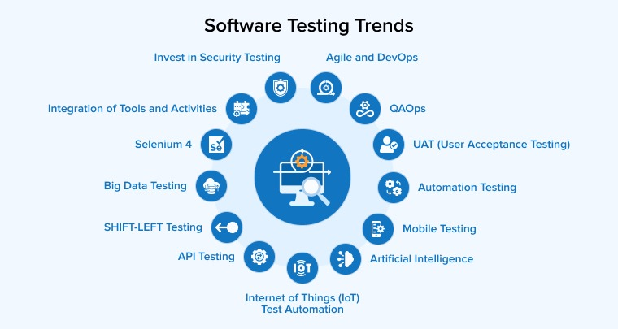
Methodology
12
5/13/2025
5/13/2025
12
12

Slide 13
Outcomes Parameter
Test Automation Efficiency – Measure the reduction in manual effort and execution time using AI-driven automation.
Defect Detection Rate – Evaluate the accuracy and effectiveness of AI-based and shift-left testing approaches in identifying defects early.
Performance Metrics – Assess system response time, scalability, and resource utilization under different load conditions.
Security Vulnerability Detection – Measure the effectiveness of security testing tools in identifying and mitigating potential threats.
Test Coverage & Mutation Score – Analyze the extent of code coverage and the effectiveness of test cases in identifying faults.
13

Slide 14
Result
The future of software testing is shaped by AI-driven automation, continuous integration, and cloud-based solutions, enhancing efficiency and accuracy in software development. AI and machine learning optimize test case generation and defect detection, reducing manual effort.
Additionally, cloud-based and IoT testing provide scalability, enabling testing across diverse environments. Cybersecurity and blockchain testing are becoming crucial to safeguard sensitive data, while performance engineering is replacing traditional performance testing to design resilient systems from the start devolpment successfully.
5/13/2025
14
14

Slide 15
Conclusion
Software testing is evolving to meet the challenges of an increasingly complex digital landscape.
By leveraging AI, automation, and cloud technologies, organizations can improve software quality, accelerate development cycles, and ensure more resilient and secure applications in the future.
The continued evolution of these trends will shape the next era of software testing, making it more intelligent, adaptive, and integral to software development success.
5/13/2025
15
15

Slide 16
Future Enhancement
As security becomes a critical concern, security testing will be deeply integrated into the software development process. DevSecOps will see further enhancements, ensuring security vulnerabilities are caught early in the development process using automated security scanning and testing.
Automated Penetration Testing: Automated tools will be enhanced to simulate attacks and identify weaknesses, ensuring that security testing is more comprehensive and effective.
Blockchain technology could be utilized to ensure test data integrity and traceability. By recording test results on a blockchain, teams can create a transparent and immutable record of all test activities, making it easier to track and audit software testing processes for compliance and security purposes.
5/13/2025
5/13/2025
16
16
16

Slide 17
References
Myers, G. J., Sandler, C., & Badgett, T. (2011). The Art of Software Testing (3rd ed.). John Wiley & Sons.
Graham, D., van Veenendaal, E., Evans, I., & Black, R. (2008). Foundations of Software Testing: ISTQB Certification. Cengage Learning.
Fewster, M., & Graham, D. (1999). Software Test Automation: Effective Use of Test Execution Tools. Addison-Wesley.
Kaner, C., Falk, J., & Nguyen, H. Q. (1999). Testing Computer Software (2nd ed.). Wiley.
Black, R. (2009). Advanced Software Testing - Vol. 1: Guide to the ISTQB Advanced Certification as an Advanced Test Analyst. Rocky Nook.

Slide 18
References
6. Garousi, V., Felderer, M., & Mäntylä, M. V. (2019). "The need for research on open-source software testing: Identifying challenges and opportunities." Information and Software Technology, 106, 1-18.
7. Yoo, S., & Harman, M. (2012). "Regression testing minimization, selection and prioritization: A survey." Software Testing, Verification & Reliability, 22(2), 67-120.
8. Mesbah, A., van Deursen, A., & Roest, D. (2012). "Invariant-based automatic testing of modern web applications." IEEE Transactions on Software Engineering, 38(1), 35-53.
9. Bertolino, A. (2007). "Software testing research: Achievements, challenges, dreams." Future of Software Engineering (FOSE '07), 85-103.
10. Harman, M., & Clark, J. A. (2004). "Metrics are fitness functions too." Proceedings of the 10th International Symposium on Software Metrics, 58-69.
18

